Slide 1
ALUMNI MANAGEMENT PORTAL
TEAM : 16
TEAM LEADER:
M. Lalitha(15JN1A05E3)
TEAM MEMBERS:
M. Devika(15JN1A05C4)
V. Mounika(15JN1A0590)
G. Chandana(15JN1A05D1)
UNDER THE GUIDENCE OF:
CH.Sri Divya asst.professor

Slide 2
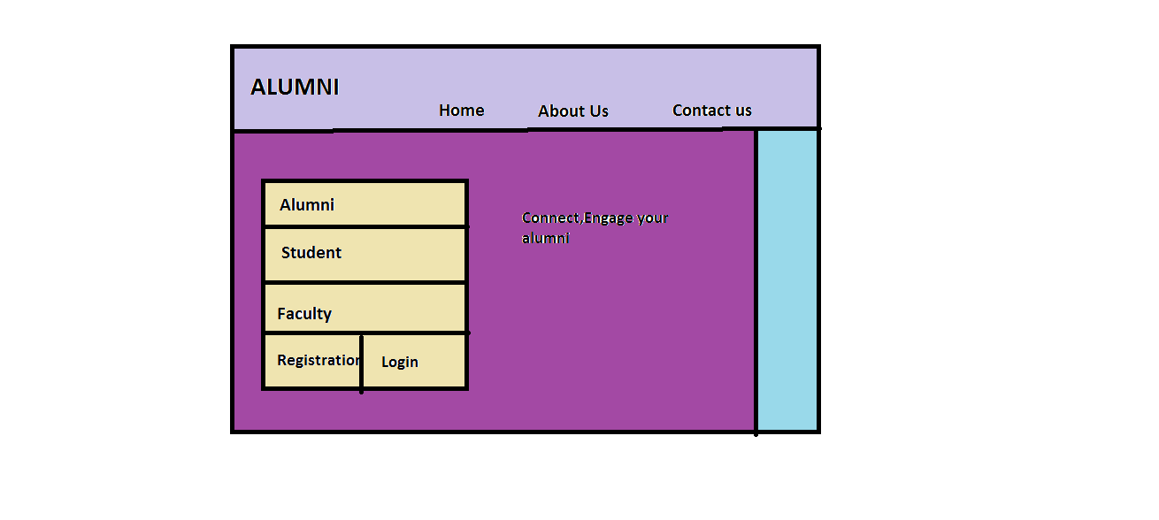

Slide 3
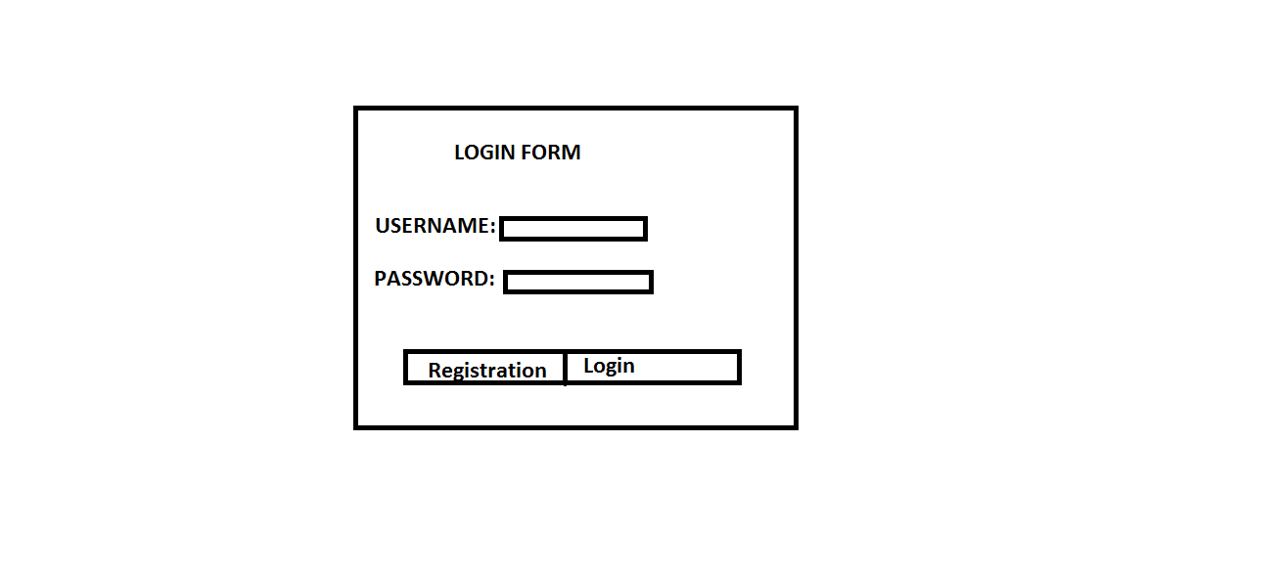

Slide 4
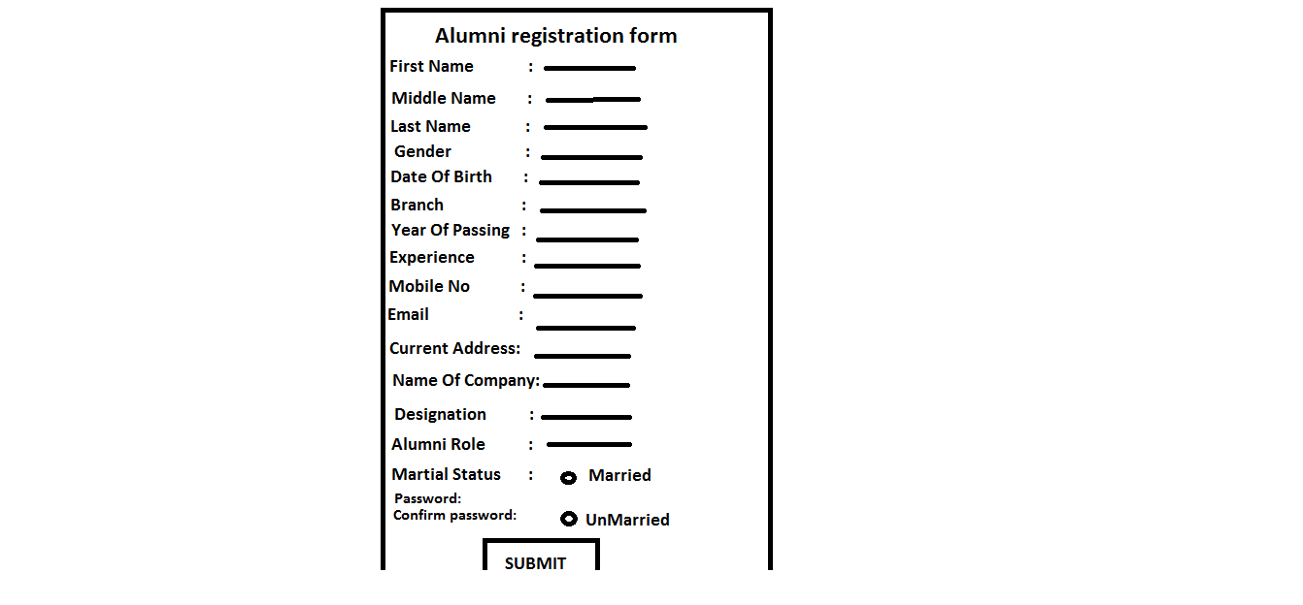

Slide 5
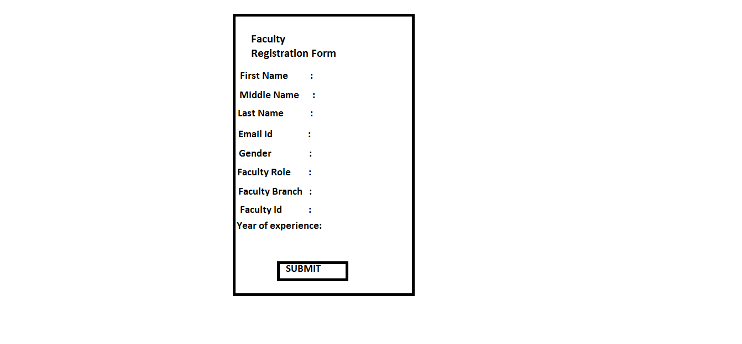

Slide 6
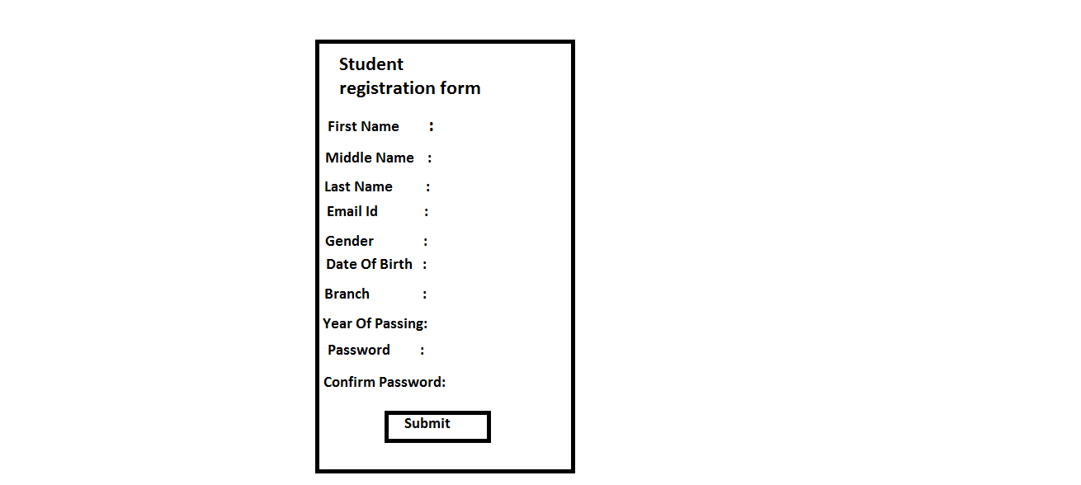

Slide 7
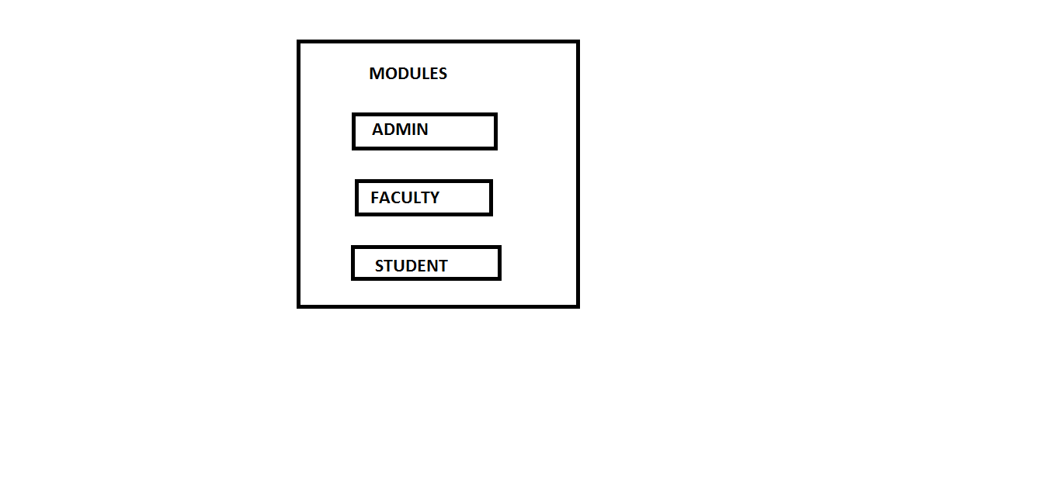

Slide 8
